Slide 1

THESIS PROJECT
IMPLEMENTATION OF IMAGE SUPER RESOLUTION NETWORK BASED ON THE XILINX ZYNQ ULTRASCALE+ MPSOC – ZCU102 EVALUATION KIT
Student Name: Ha Nguyen Minh Phuoc
ID: 20161245
HO CHI MINH CITY – 01/07/2024

Slide 2

01
TABLE OF CONTENT
Problem Statement
02
Problem Solving
03
Achieved
Result
04
Conclusion
05
Future
Direction

Slide 3

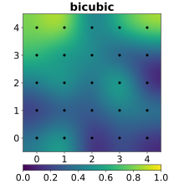
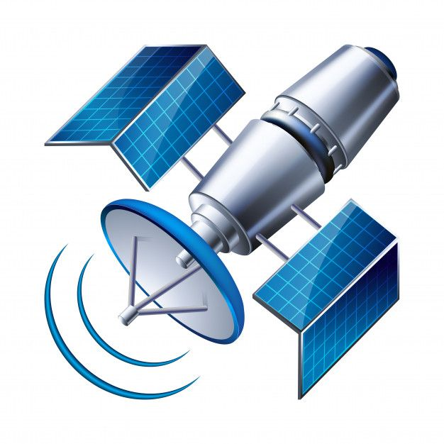

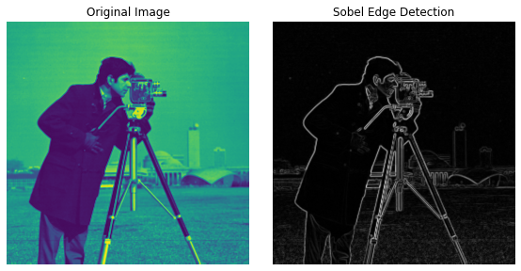
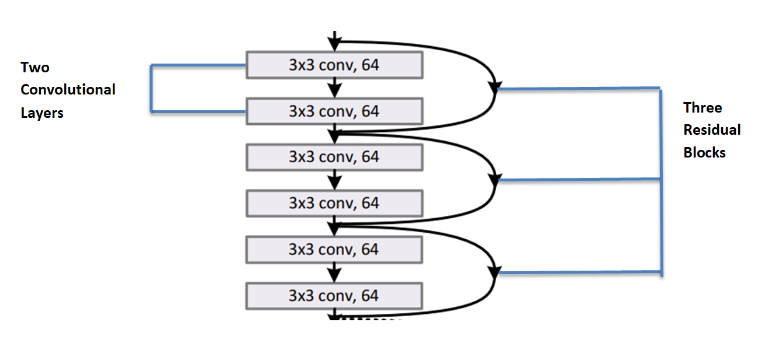
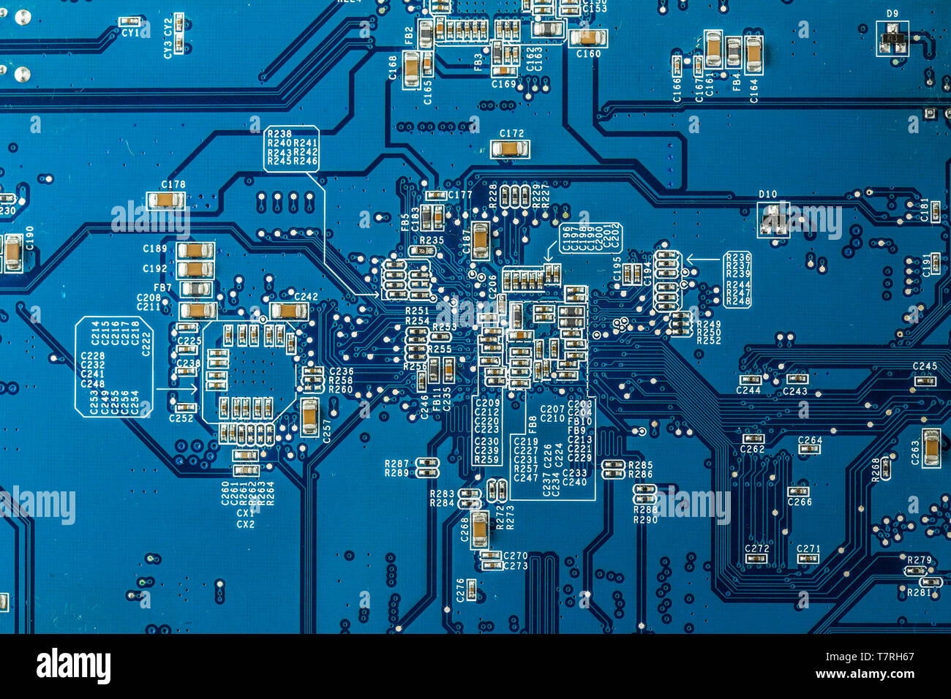
1. PROBLEM STATEMENT
HIGH RESOLUTION IMAGE
Methods to Enhance Image Resolution from Low Resolution (LR) to High Resolution (HR)
Residual Channel Attention Network
(RCAN)
Interpolation
Statistical Models
Sobel
Deep Learning

Slide 4

1. PROBLEM STATEMENT
Training Residual Channel Attention Network
(RCAN) on Kaggle.
Experiment with the RCAN model on ZCU102.
4

Slide 5


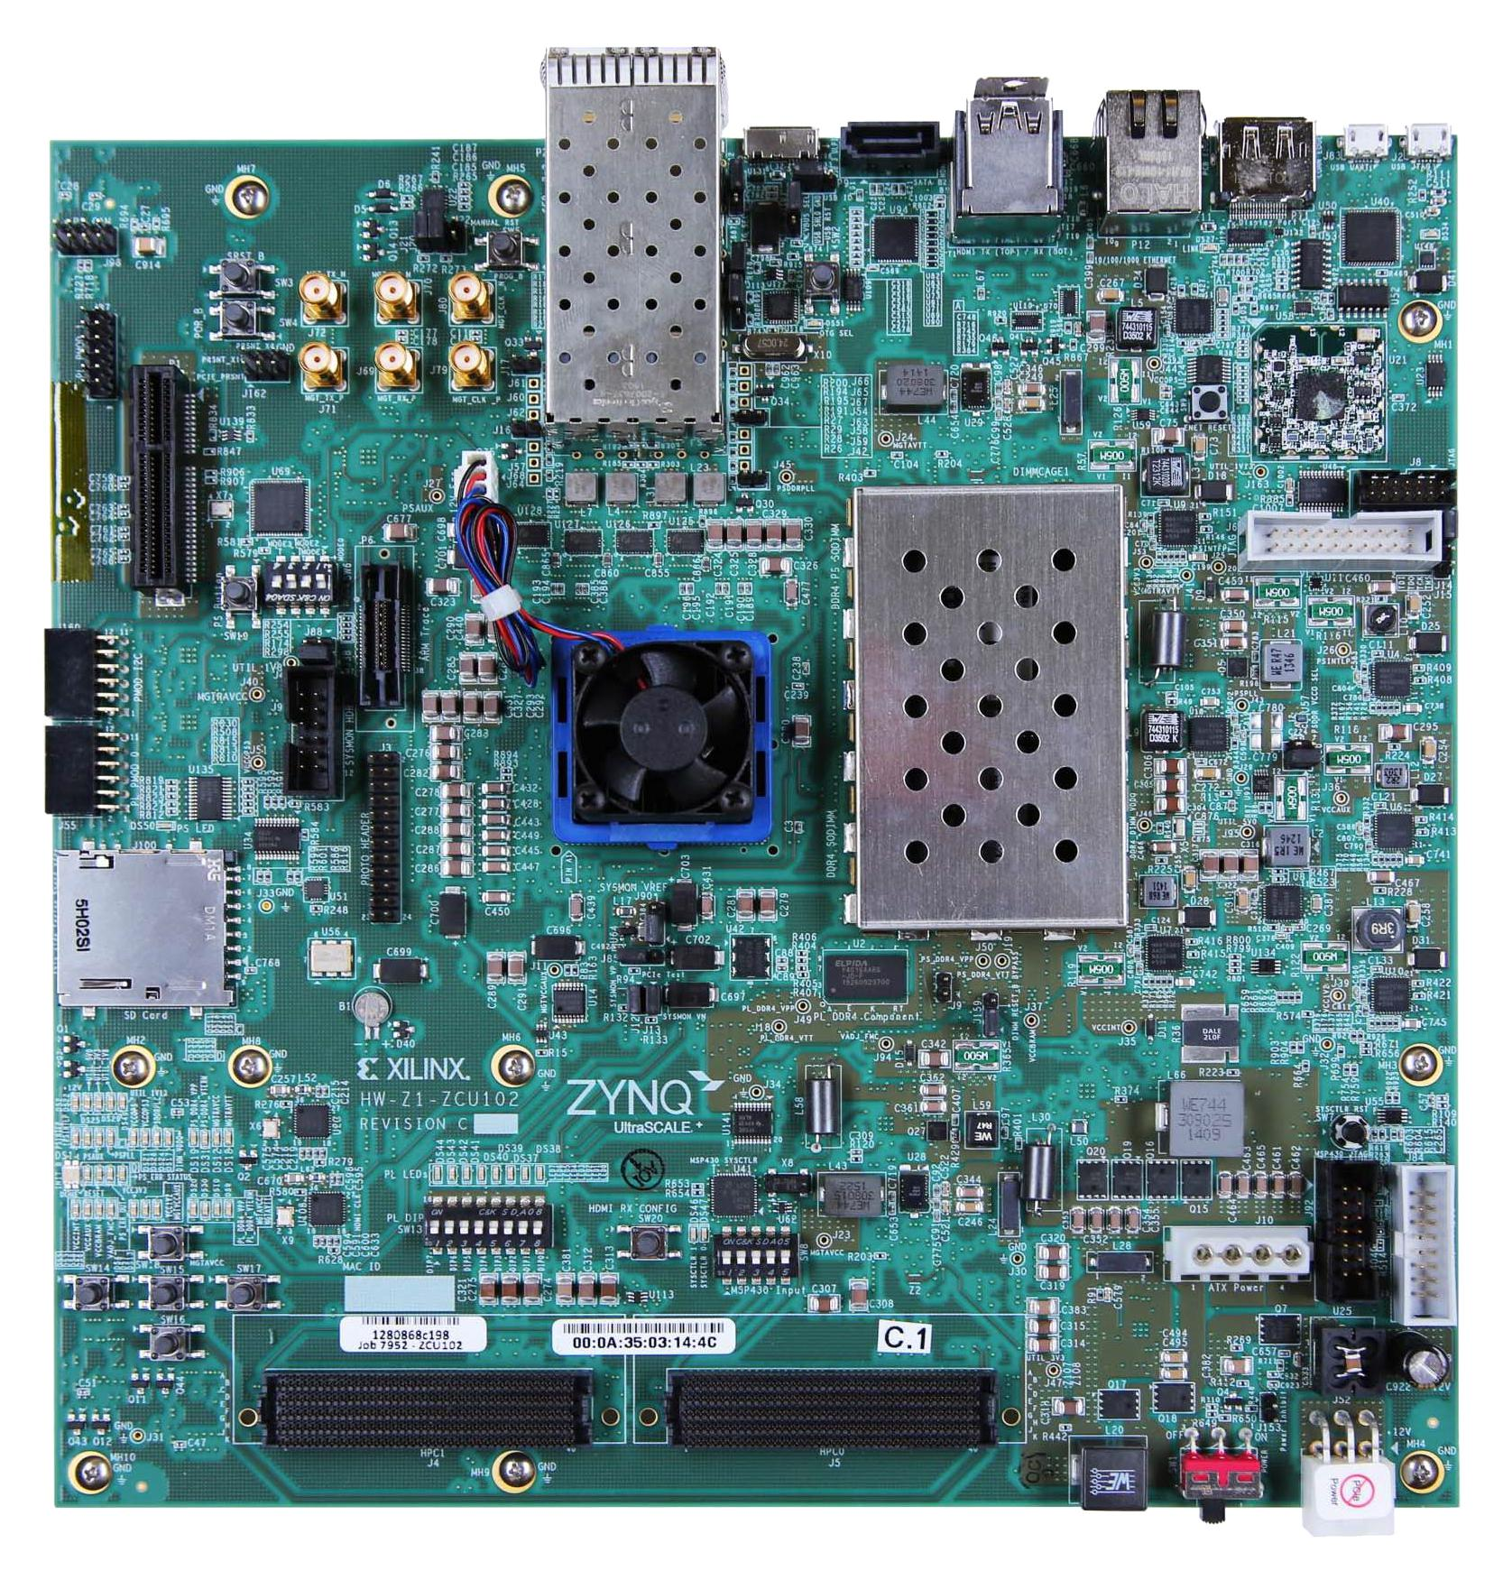

2. PROBLEM SOLVING
SYSTEM SPECIFICATION DIAGRAM
Hardware
Dataset
Use to train RCAN model.
High Resolution: 2000x2000 pixels.
800 images for training.
100 images for validation, and 100 images for the final test set.
Diversity: landscapes, portraits, objects, architecture, etc.
DIV2K
RCAN
Use to test RCAN model on ZCU102.
There are 3 subsets of low-quality images.
There are 1 subsets of low-quality images.
Benchmark
5

Slide 6
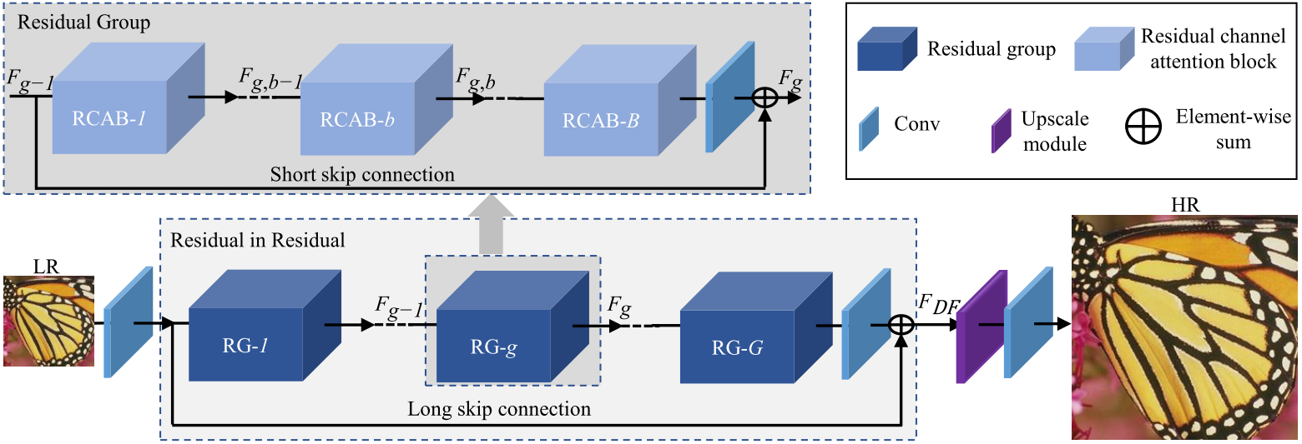
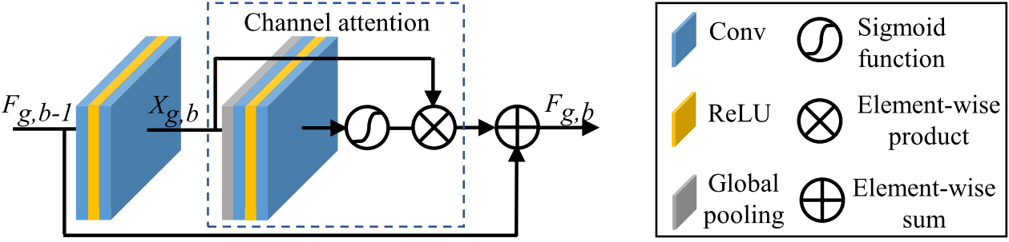
2. PROBLEM SOLVING
SYSTEM SPECIFICATION DIAGRAM
Dataset
DIV2K
RCAN
Benchmark
Learning Rate | 3e-4 (0.03)
BETAS | 0.9 , 0.999
Step size | 10
GAMMA | 0.67
NUM_EPOCHS | 100
DEVICE | Cuda
6

Slide 7



2. PROBLEM SOLVING
SYSTEM SPECIFICATION DIAGRAM
Design Hardware Platform use IP Cores
Dataset
DIV2K
RCAN
Build kernel Linux for ZCU102
Benchmark
Deploy RCAN onto ZCU102
7

Slide 8
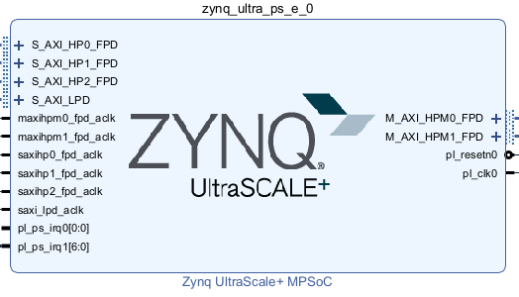
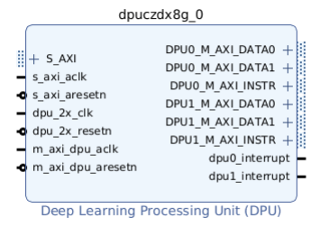
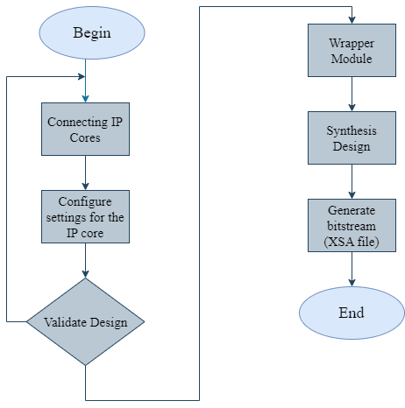
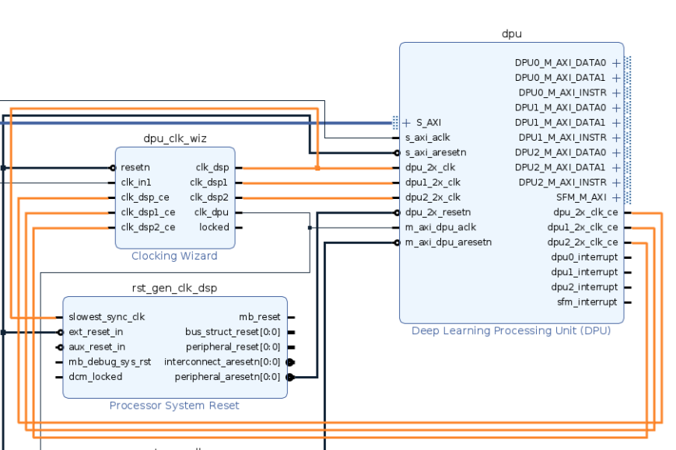
2. PROBLEM SOLVING
Design Hardware Platform use IP Cores
Number of DPU Core | 1
Arch of DPU | B4096
Ram Usage | Low
Alu Relu Type | ReLU + ReLU6
Number of SMF cores | 1
AXI Protocol | AXI4
clk_dsp | 650 MHz
clk_dpu | 325MHz
Duty Cycle | 50%
8

Slide 9
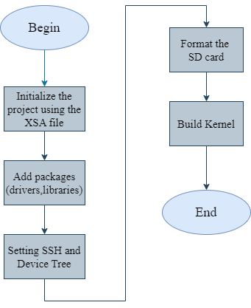
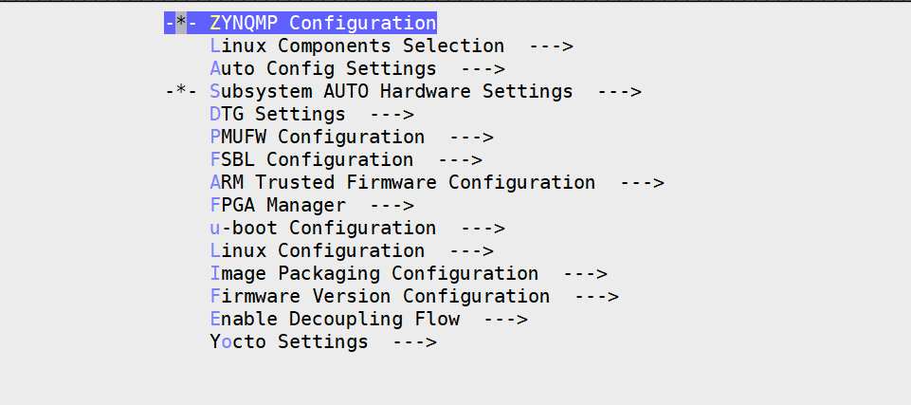
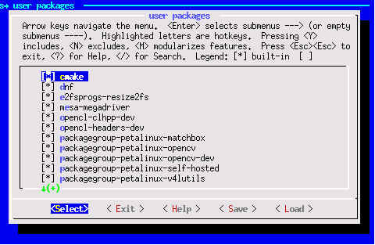

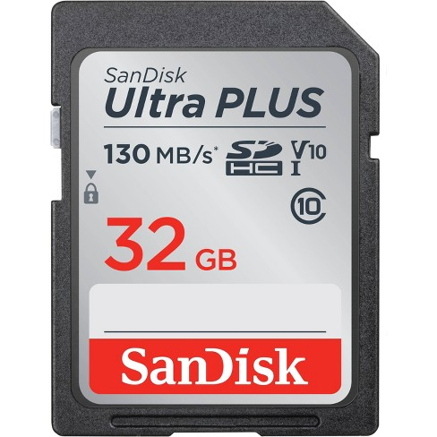
2. PROBLEM SOLVING
Design Hardware Platform use IP Cores
Build kernel Linux for ZCU102
FAT32
Deploy RCAN onto ZCU102
EXT4
9

Slide 10
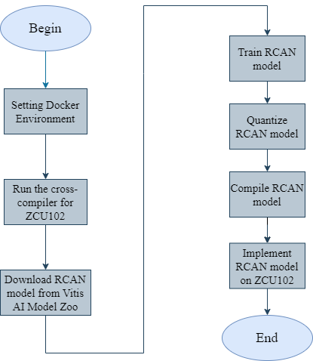
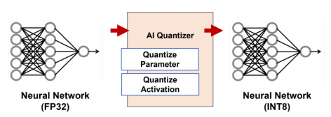
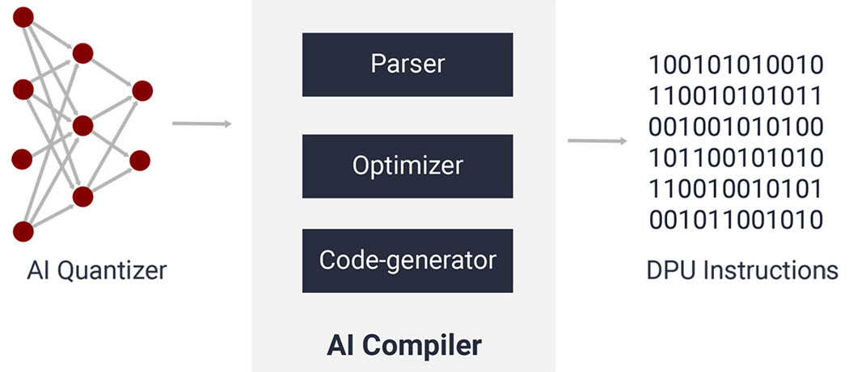
2. PROBLEM SOLVING
Build kernel Linux for ZCU102
Design Hardware Platform use IP Cores
Deploy RCAN onto ZCU102
10

Slide 11
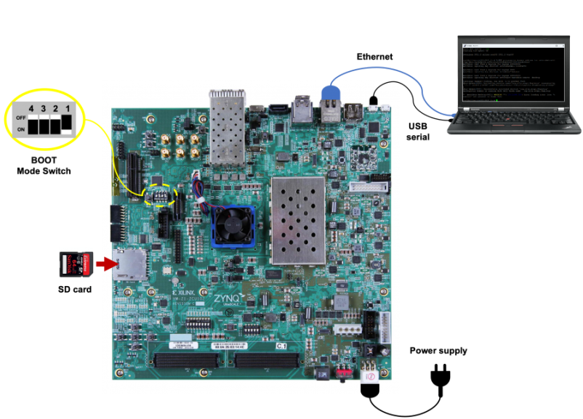
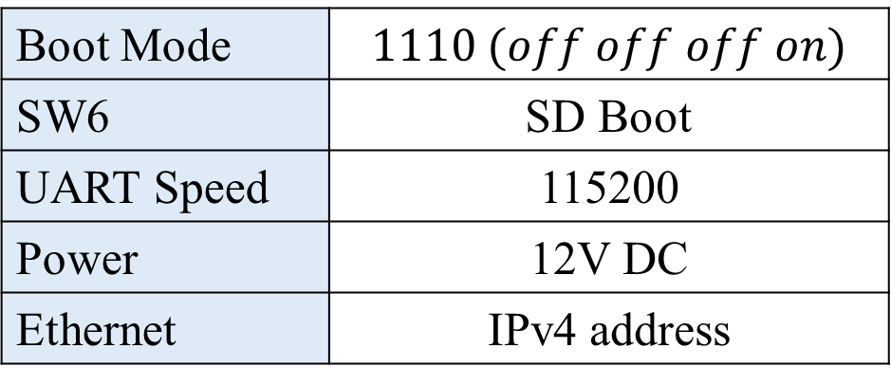
2. PROBLEM SOLVING
Designing Embedded System run on ZCU102
Deploying the super-resolution network RCAN on ZCU102
Boot Mode | $$1110 (off off off on)$$
SW6 | SD Boot
UART Speed | 115200
Power | 12V DC
Ethernet | IPv4 address
11

Slide 12
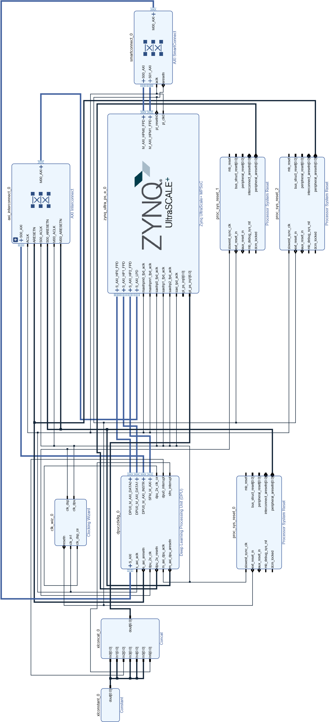
3. ARCHIEVED RESULT
12

Slide 13
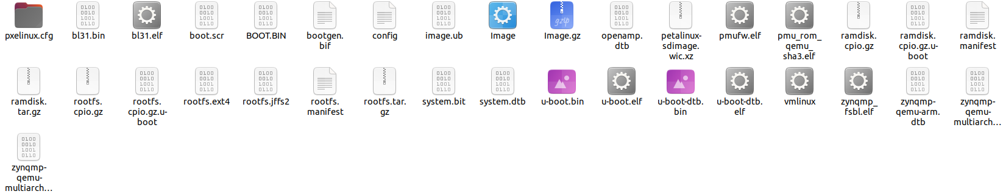
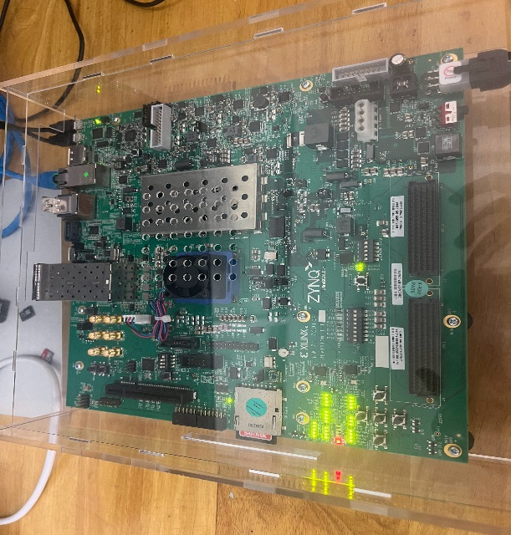
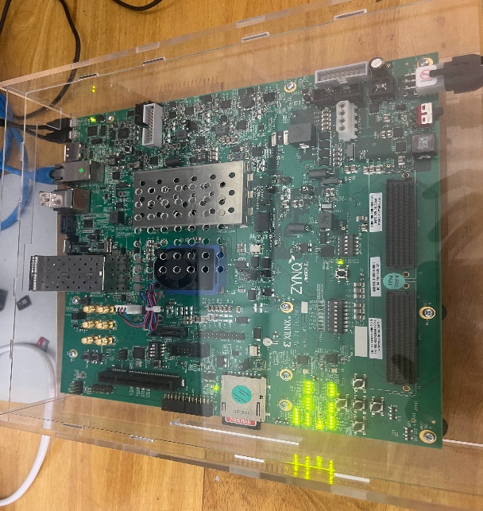
3. ARCHIEVED RESULT
Constrain | LUT | FF | BRAM | URAM | DSP
DPU_zynq_ultra_ps_e_0_0 | 264 | 0 | 0 | 0 | 0
DPU_clk_wiz_0_0 | 1 | 0 | 0 | 0 | 0
DPU_proc_sys_reset_0_0 | 19 | 40 | 0 | 0 | 0
DPU_proc_sys_reset_0_1 | 24 | 40 | 0 | 0 | 0
DPU_dpuczdx8g_0_0 | 61893 | 107918 | 259 | 0 | 724
Các tập tin được tạo sau khi build kernel Linux
ZCU102 vừa bật nguồn
ZCU102 khởi động hoàn tất
13

Slide 14
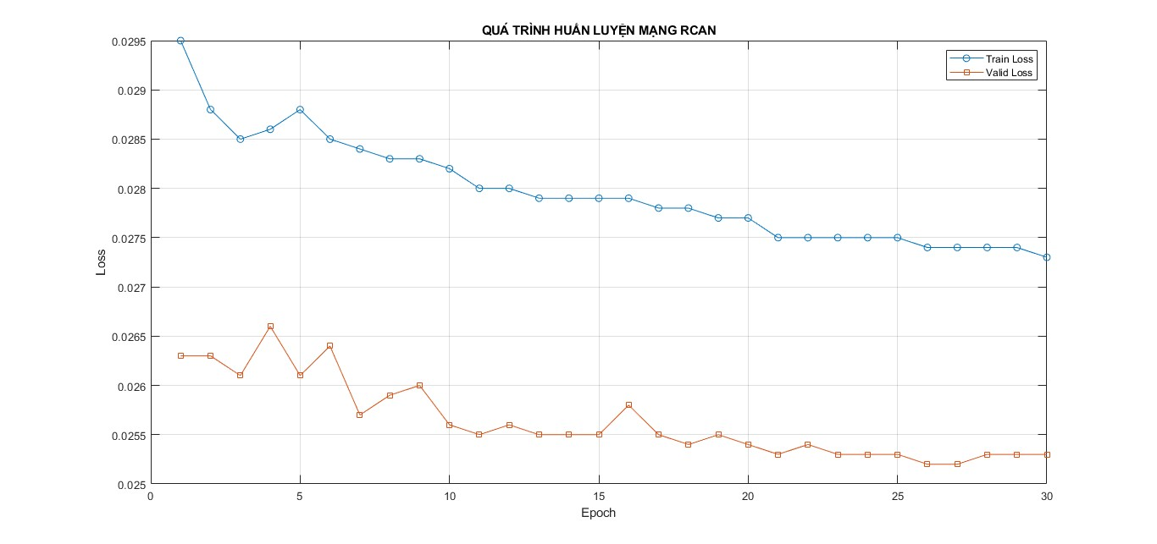
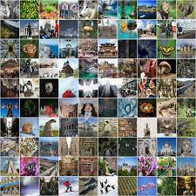
3. ARCHIEVED RESULT
Training
DIV2K dataset
14

Slide 15
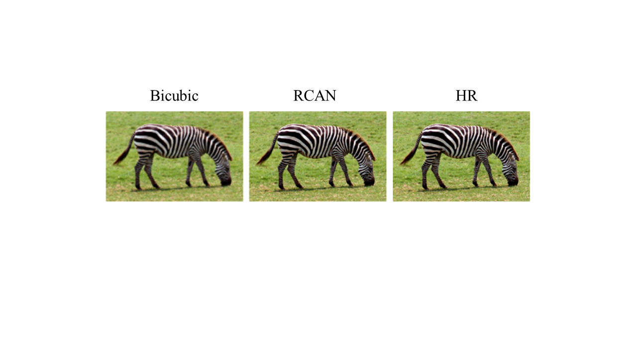
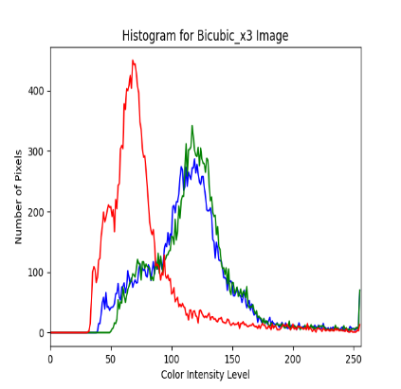
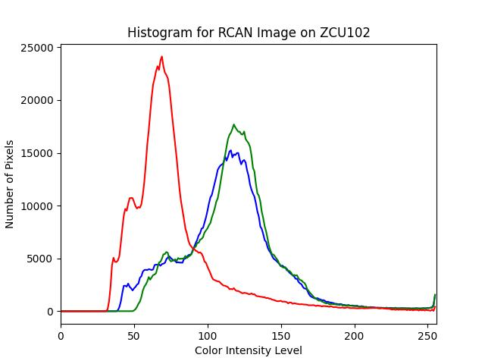
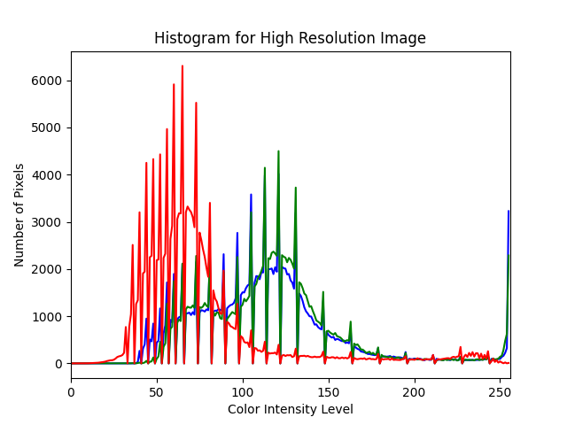
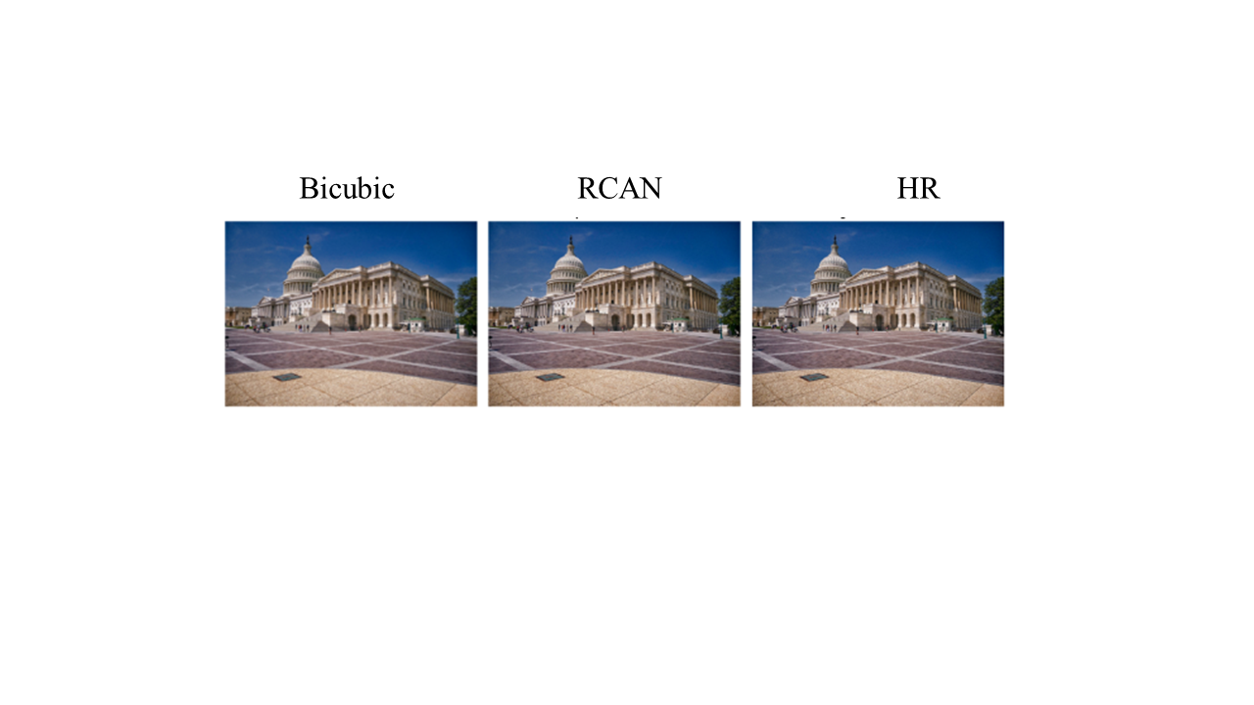
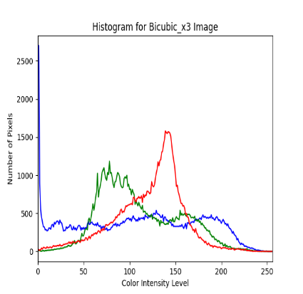
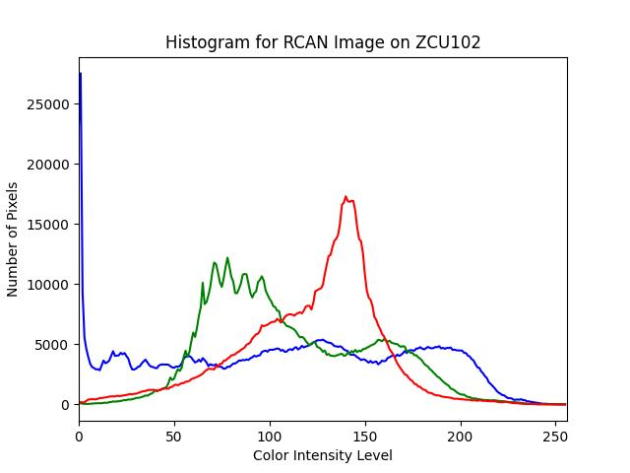
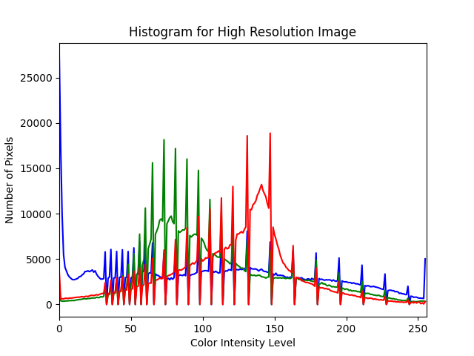
3. ARCHIEVED RESULT
Perform Image Super-Resolution on ZCU102
image file 253027.png from the B100 dataset
image file img073.png from the Urban100 dataset
15

Slide 16
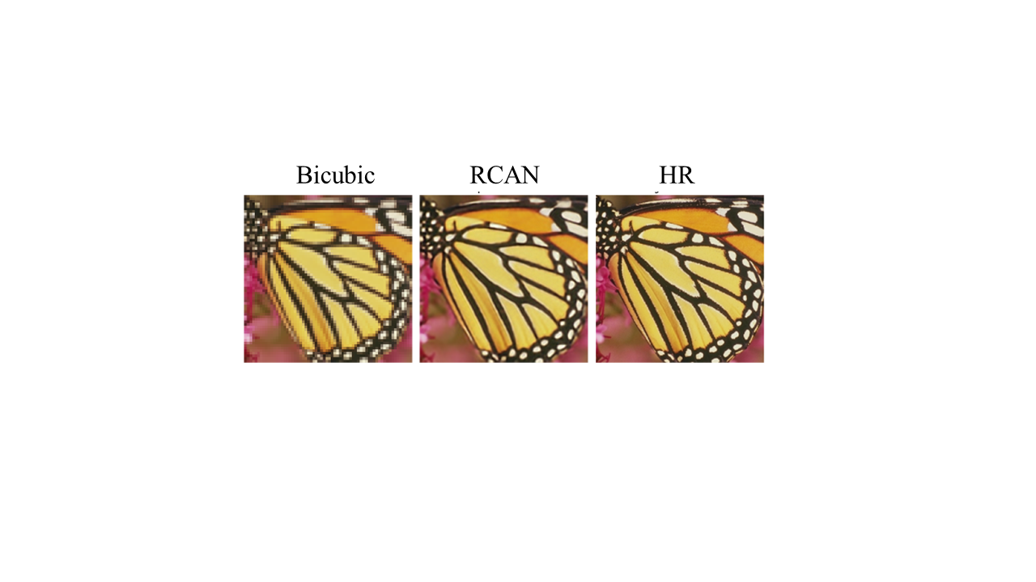
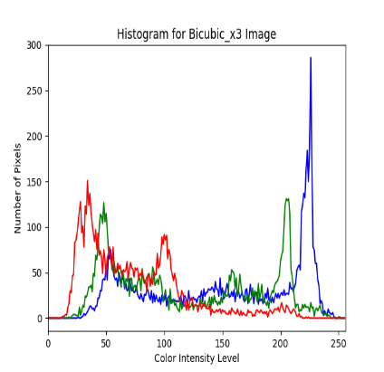
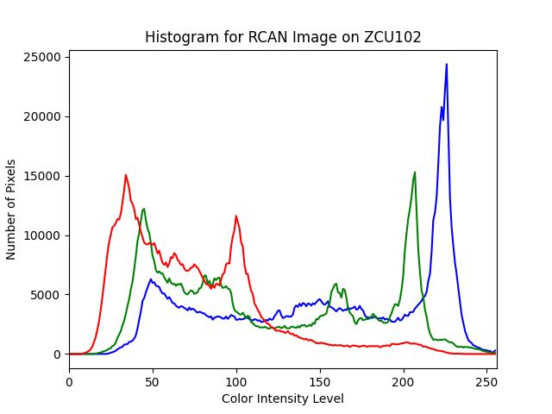
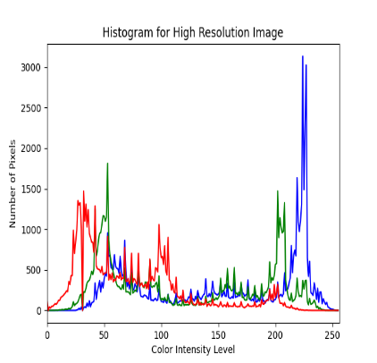
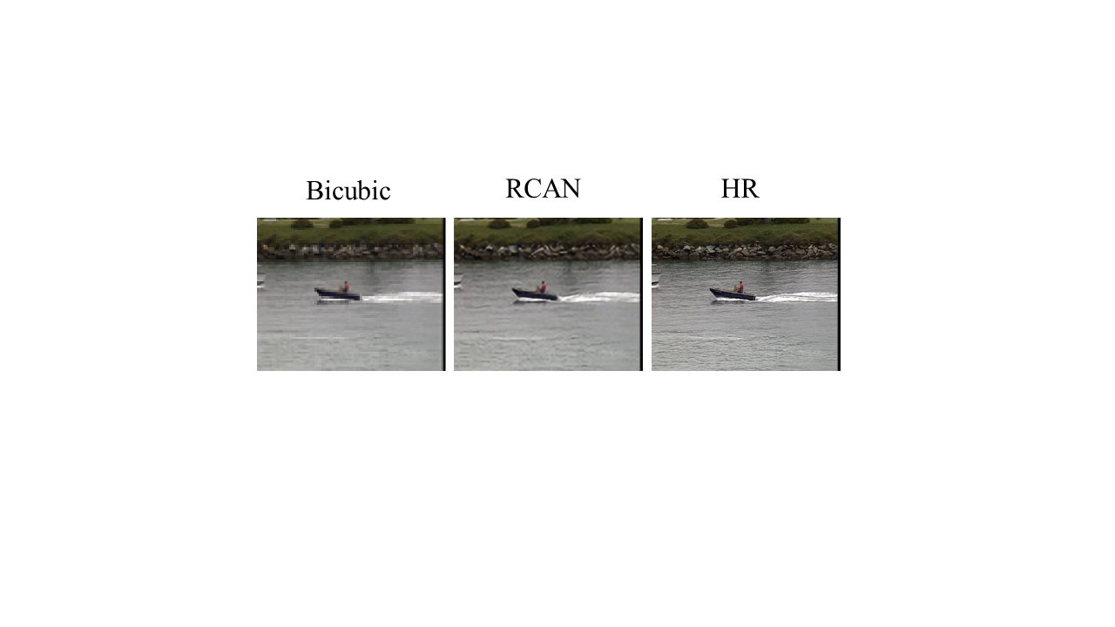
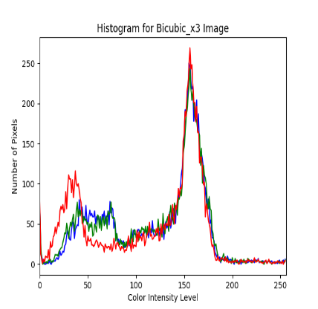
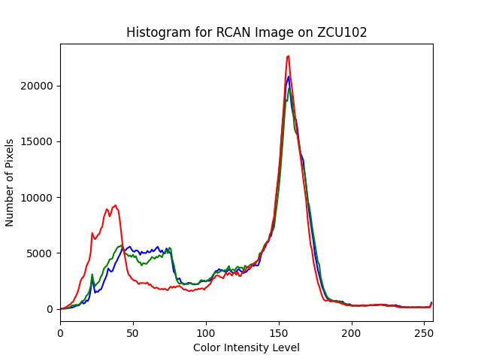
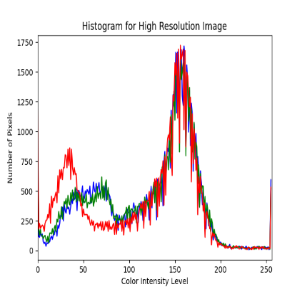
3. ARCHIEVED RESULT
Perform Image Super-Resolution on ZCU102
image file butterfly.png from the Set5 dataset
image file coastguard.png from the Set14 dataset
16

Slide 17
3. ARCHIEVED RESULT
Perform Image Super-Resolution on ZCU102
 |  | Bicubic | HR | RCAN
253027 | Kích thước(pixels) | 160×107 | 481×321 | 1280×720
 | Dung lượng | 34.7 KB | 290 KB | 259 KB
img070 | Kích thước(pixels) | 341×256 | 1024×769 | 1280×720
 | Dung lượng | 160 KB | 1.47 MB | 1.02 MB
butterfly | Kích thước(pixels) | 85 × 85 | 256×256 | 1280×720
 | Dung lượng | 16.9 KB | 124 KB | 101KB
coastguard | Kích thước(pixels) | 117×96 | 117×96 | 1280×720
 | Dung lượng | 19.6KB | 150 KB | 89.8 KB

Slide 18
3. ARCHIEVED RESULT
Compare the results of running RCAN on Kaggle
Biểu đồ thông số PSNR của 4 ảnh chạy trên Cloud (Kaggle) và ZCU102
Biểu đồ thông số SSIM của 4 ảnh chạy trên Cloud (Kaggle) và ZCU102

Slide 19
4. CONCLUSION
Achieved
Understand the structure of the RCAN network and train the model on Kaggle.
Understand the structure of an SoC - ZCU102.
Build a Linux operating system for the ZCU102.
Experiment with the RCAN network running on the ZCU102.
19

Slide 20
4. CONCLUSION
Limitation
Unable to directly set the output image size.
Super-resolution images from large-sized images (>1MB) do not meet the desired requirements.
Hardware resources are limited.
20

Slide 21
5. FUTURE DIRECTION
Improve the performance of the model.
Resize images directly.
Running other models like GAN, VDSR on ZCU102
21

Slide 22
Thank you
for your listening!

